Slide 1
Cardiac Embryology
Chris Cunningham, M1

Slide 2
Outline
Review basic anatomy/physiology of the heart
Heart Organogenesis
Prenatal Circulation
Neonatal changes
Clinical application of concepts

Slide 3
Cardiovascular Physiology
Humans, mammals and birds have a 2 circuit system: a pulmonary and systemic circuit
Humans, mammals and birds have a 4 chambered heart; whereas amphibians have a 3 chambered heart
Vessels that transport blood away from the heart are arteries
Vessels that transport blood towards the heart are veins
The contractile cell in the heart is called a myocyte

Slide 4
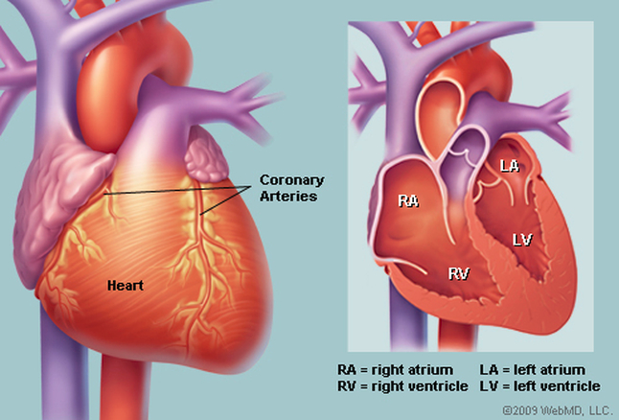
Notes:
https://www.webmd.com/heart/picture-of-the-heart#1

Slide 5
Notes:
http://www.majordifferences.com/2013/02/difference-between-artery-and-vein.html#.WpxR-edOmM8

Slide 6
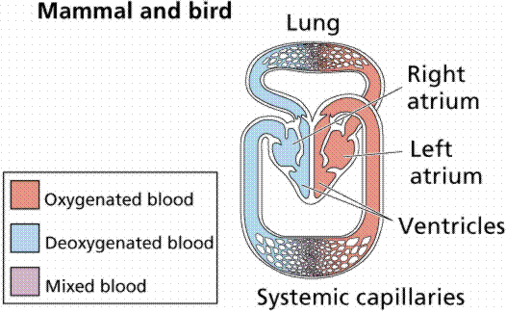
Notes:
https://www2.estrellamountain.edu/faculty/farabee/biobk/BioBookcircSYS.html

Slide 7
Notes:
https://presentmam.blogspot.com/2015/04/types-of-muscles.html

Slide 8
The heart is a pump
The heart generates pressure gradients in which blood flows from high to low pressures
Blood flow is required for body tissue perfusion
Delivery of O2, glucose and nutrients, removal of CO2 and wastes

Slide 9
Organogenesis
The CV system arises from the mesoderm
Angioblasts initially replicate in clusters over the embryo and begin to form lumens, which fuse to create a primitive network of interconnected vessels
Notes:
The Developing Human
10th Edition
Clinically Oriented Embryology
Authors: Keith Moore T. V. N. Persaud Mark Torchia
eBook ISBN: 9780323313513
Imprint: Saunders
Published Date: 6th April 2015

Slide 10
Organogenesis
Folding of the embryo brings angioblastic cords together to make a primitive heart tube, which starts contracting
A
B
Notes:
The Developing Human
10th Edition
Clinically Oriented Embryology
Authors: Keith Moore T. V. N. Persaud Mark Torchia
eBook ISBN: 9780323313513
Imprint: Saunders
Published Date: 6th April 2015

Slide 11
C
D
Notes:
The Developing Human
10th Edition
Clinically Oriented Embryology
Authors: Keith Moore T. V. N. Persaud Mark Torchia
eBook ISBN: 9780323313513
Imprint: Saunders
Published Date: 6th April 2015

Slide 12
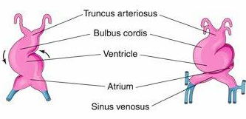
The Primitive Heart Tube SV -> A -> V -> BC -> TA The Tube “Loops”
Notes:
The Developing Human
10th Edition
Clinically Oriented Embryology
Authors: Keith Moore T. V. N. Persaud Mark Torchia
eBook ISBN: 9780323313513
Imprint: Saunders
Published Date: 6th April 2015

Slide 13
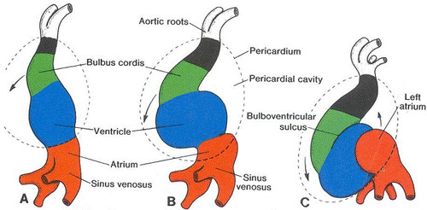
Notes:
https://webcampus.drexelmed.edu/neurobio/embryology/page51/page52/

Slide 14
Organogenesis
Once the primitive heart tube loops, we need to establish 4 more divisions:
Atrial Separation
Ventricular Separation
Atrioventricular separation (Heart Valves)
Aorticopulmonary Septum
The central structure in these processes is the endocardial cushion

Slide 15
Notes:
The Developing Human
10th Edition
Clinically Oriented Embryology
Authors: Keith Moore T. V. N. Persaud Mark Torchia
eBook ISBN: 9780323313513
Imprint: Saunders
Published Date: 6th April 2015

Slide 16
Atrial Subdivision
ALWAYS NEED A HOLE BETWEEN THE ATRIA
Multiple steps: 2 sequential septa, 3 sequential openings = 5 structures
Common for mistakes to occur -> congenital anomalies (Atrial Septal Defects)

Slide 17
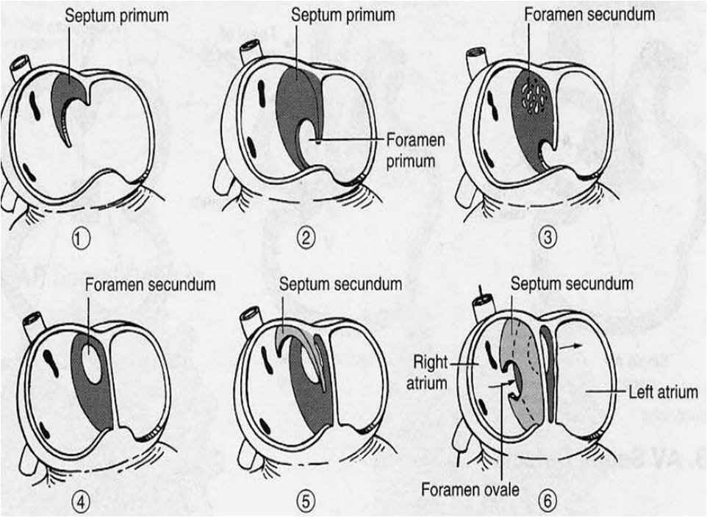
Atrial Subdivision
Step 1: Septum Primum grows from the roof to the endocardial cushion
Step 2: Foramen primum is a consequence of downward growth
Step 3: Additional holes form in the septum primum which coalesce into the foramen secundum
Step 4: Septum secundum begins to grow, leaving open the foramen ovale
Notes:
The Developing Human
10th Edition
Clinically Oriented Embryology
Authors: Keith Moore T. V. N. Persaud Mark Torchia
eBook ISBN: 9780323313513
Imprint: Saunders
Published Date: 6th April 2015

Slide 18
Atrial Subdivision
A
Notes:
The Developing Human
10th Edition
Clinically Oriented Embryology
Authors: Keith Moore T. V. N. Persaud Mark Torchia
eBook ISBN: 9780323313513
Imprint: Saunders
Published Date: 6th April 2015

Slide 19
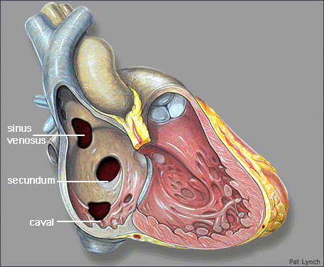
Notes:
http://slideplayer.com/slide/10297344/

Slide 20
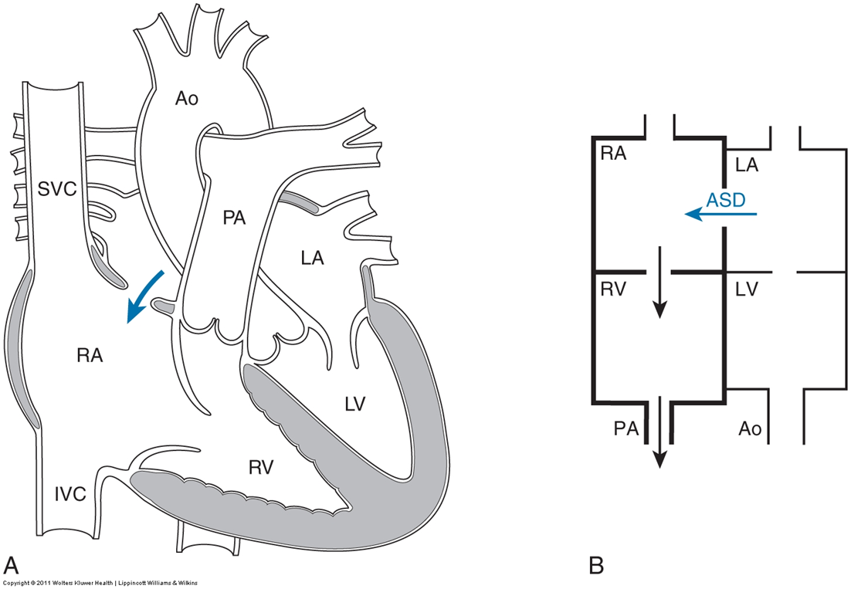
Notes:
The Developing Human
10th Edition
Clinically Oriented Embryology
Authors: Keith Moore T. V. N. Persaud Mark Torchia
eBook ISBN: 9780323313513
Imprint: Saunders
Published Date: 6th April 2015

Slide 21
Ventricular Subdivision
Interventricular Septum grows from the floor to the endocardial cushion. Muscular and membranous parts.
Common for mistakes to occur -> congenital anomalies (Ventricular Septal Defect VSD)
Interventricular septum
Notes:
The Developing Human
10th Edition
Clinically Oriented Embryology
Authors: Keith Moore T. V. N. Persaud Mark Torchia
eBook ISBN: 9780323313513
Imprint: Saunders
Published Date: 6th April 2015

Slide 22
C
D
Notes:
The Developing Human
10th Edition
Clinically Oriented Embryology
Authors: Keith Moore T. V. N. Persaud Mark Torchia
eBook ISBN: 9780323313513
Imprint: Saunders
Published Date: 6th April 2015

Slide 23
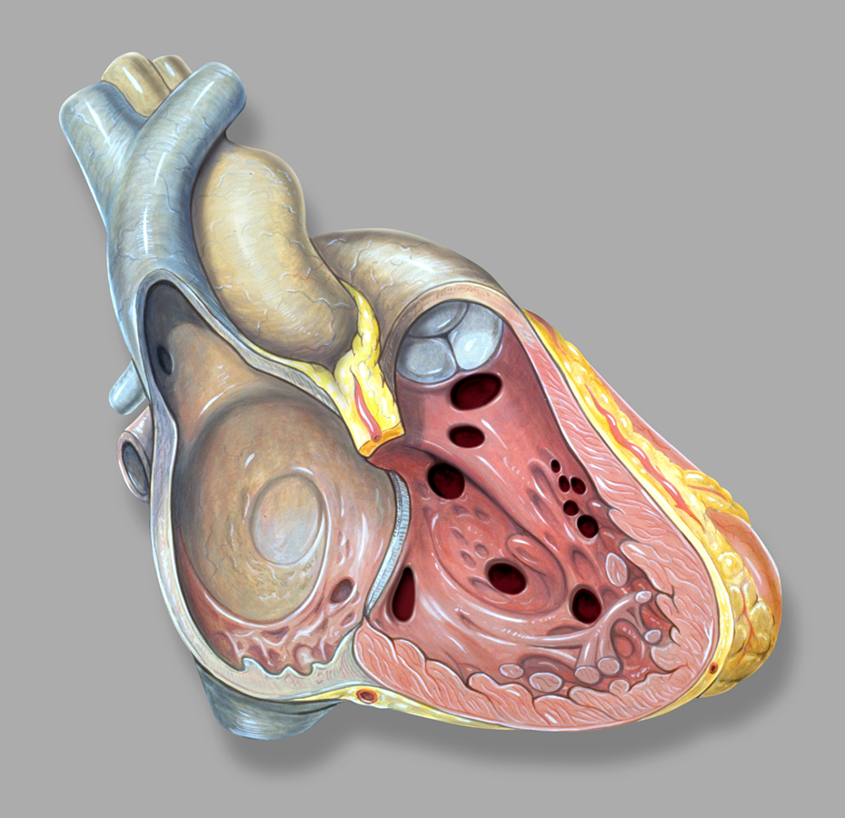
Membranous (70%)
Muscular (20%)
Notes:
https://commons.wikimedia.org/wiki/File:Heart_right_vsd.jpg

Slide 24
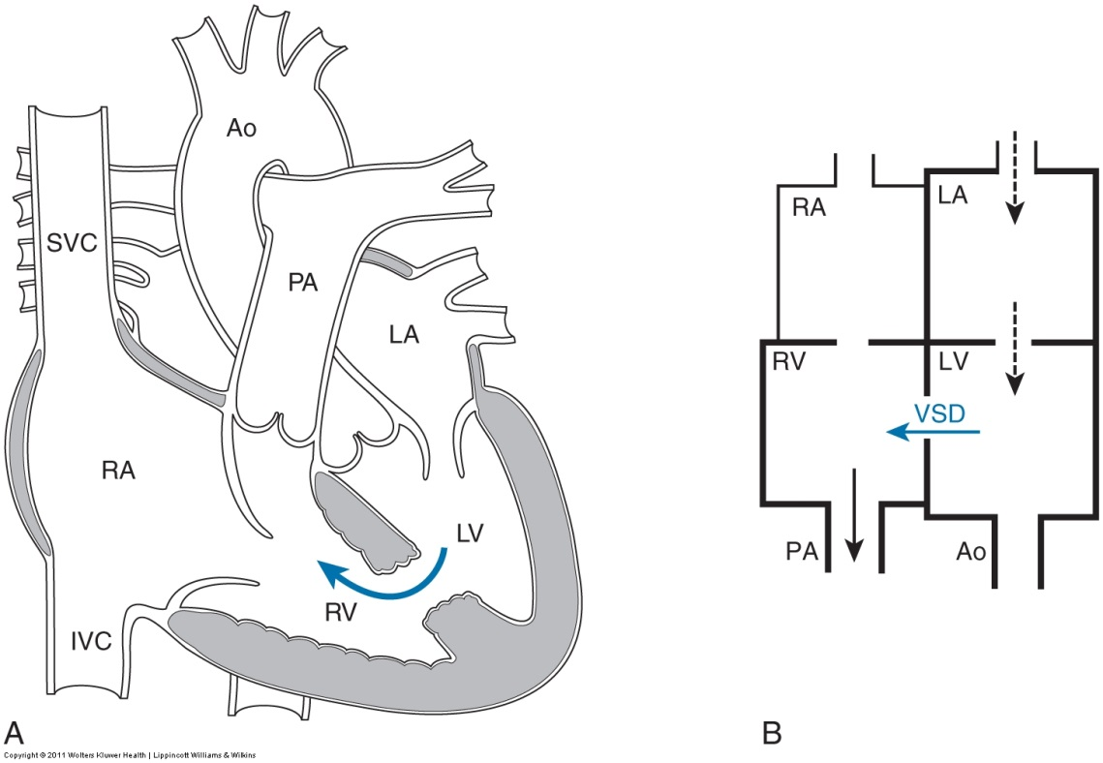
Notes:
The Developing Human
10th Edition
Clinically Oriented Embryology
Authors: Keith Moore T. V. N. Persaud Mark Torchia
eBook ISBN: 9780323313513
Imprint: Saunders
Published Date: 6th April 2015

Slide 25
Atrioventricular Septation
Arise from the endocardial cushions
B
Notes:
The Developing Human
10th Edition
Clinically Oriented Embryology
Authors: Keith Moore T. V. N. Persaud Mark Torchia
eBook ISBN: 9780323313513
Imprint: Saunders
Published Date: 6th April 2015

Slide 26
Aortiopulmonary Septation
The Truncus Arteriosus subdivides into the aorta and pulmonary artery
A longitudinal septum forms and twists
Notes:
The Developing Human
10th Edition
Clinically Oriented Embryology
Authors: Keith Moore T. V. N. Persaud Mark Torchia
eBook ISBN: 9780323313513
Imprint: Saunders
Published Date: 6th April 2015

Slide 27
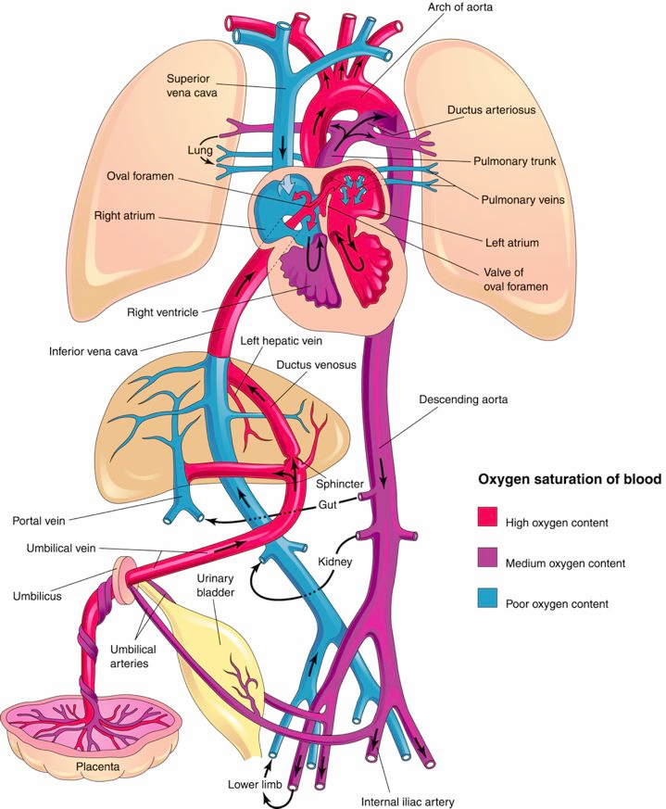
Prenatal Circulation
3 vessels
Umbilical vein
Umbilical arteries
3 shunts:
- Ductus venosus
- Oval foramen
● Most IVC blood passes
through foramen → LA → LV
→ aorta → upper body
● Most SVC blood passes
RA → RV → pulm.artery
Ductus arteriosus
● Most Pulm. artery blood
passes → ductus (high
resistance in pulm arteries)
● Blood from ductus →
lower body.
Notes:
The Developing Human
10th Edition
Clinically Oriented Embryology
Authors: Keith Moore T. V. N. Persaud Mark Torchia
eBook ISBN: 9780323313513
Imprint: Saunders
Published Date: 6th April 2015

Slide 28
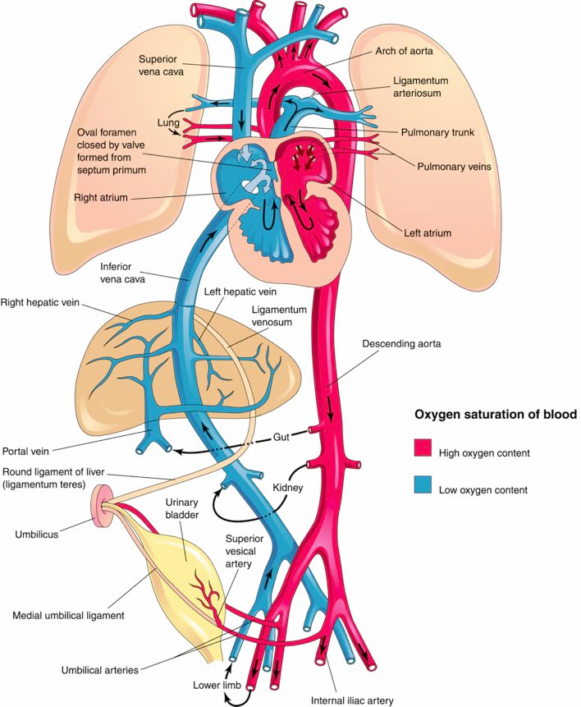
Postnatal circulation
After birth, the 6 structures needed only in-utero must close. They eventually become fibrotic.Their remnants have new names.
Umbilical vein Ligamentum teres
Umbilical arteries Medial umbilical ligaments
3 shunts:
Ductus venosus Ligamentum venosum
Oval foramen Oval fossa
Ductus arteriosus Ligamentum arteriosum
Notes:
The Developing Human
10th Edition
Clinically Oriented Embryology
Authors: Keith Moore T. V. N. Persaud Mark Torchia
eBook ISBN: 9780323313513
Imprint: Saunders
Published Date: 6th April 2015

Slide 29
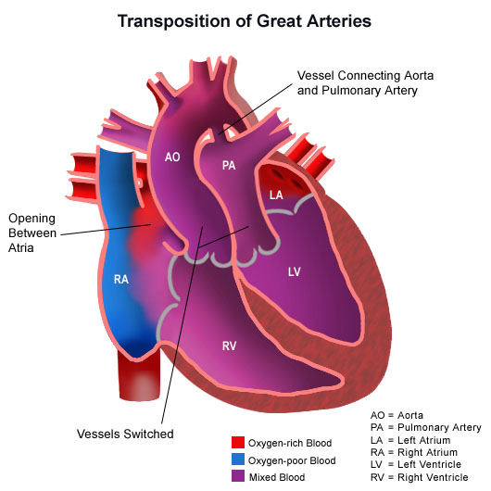
Transposition of the Great Vessels
What could cause this?
What is needed for the infant to survive?
Notes:
http://www.stanfordchildrens.org/en/topic/default?id=transposition-of-the-great-arteries-tga-90-P01823

Slide 30
Tricuspid Atresia
What is required for viability?
Notes:
http://www.stanfordchildrens.org/en/topic/default?id=tricuspid-atresia-ta-90-P01819

Slide 31
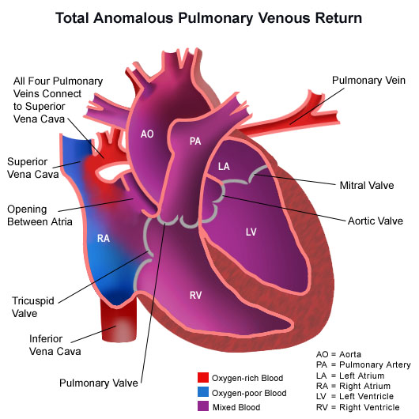
Total Anomalous Pulmonary Venous Return (TAPVR)
What is required for viability?
Notes:
http://www.stanfordchildrens.org/en/topic/default%3Fid%3Dtotal-anomalous-pulmonary-venous-return-90-P01820&rct

Slide 32
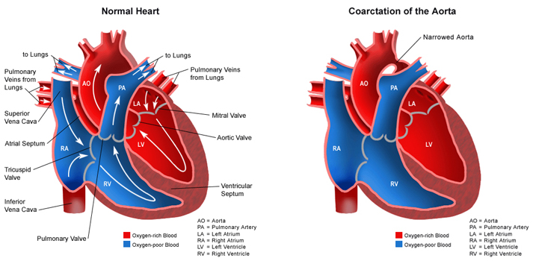
To Arms + Head
Notes:
http://www.stanfordchildrens.org/en/topic/default?id=coarctation-of-the-aorta-90-P01770

Slide 33
Extra Resources
https://www.youtube.com/watch?v=5DIUk9IXUaI
https://www.youtube.com/watch?v=RpZHiwkFUM4

